Slide 1


Hosted by:
Servers and Databases
Where all the magic happens

Slide 2


More Workshops This Year!
https://making.engr.wisc.edu

Slide 3

What is a GPU
Graphics Processing Unit
Separate hardware designed to process graphics

Slide 4
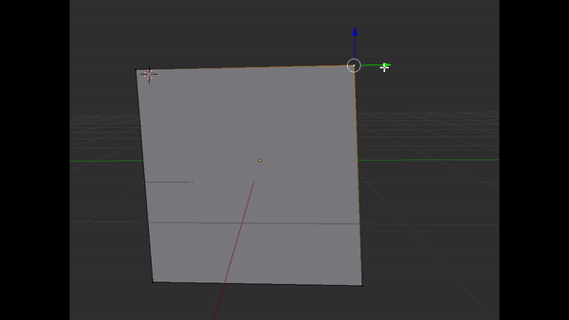
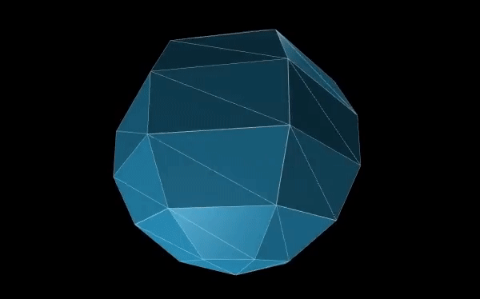
Why all this trouble for GPU
I want to move a vertex
…LOTS of vertices
1 second
16.66 ms per frame
60 frames

Slide 5
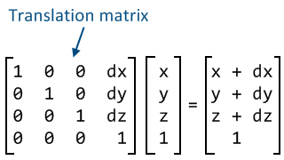

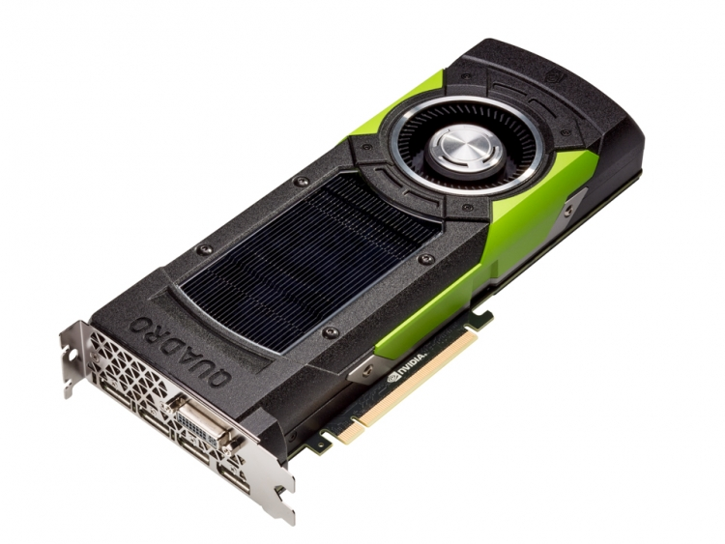
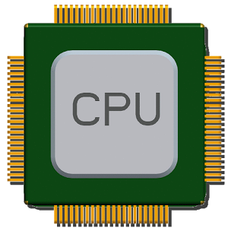
GPU designed for parallel

Slide 6

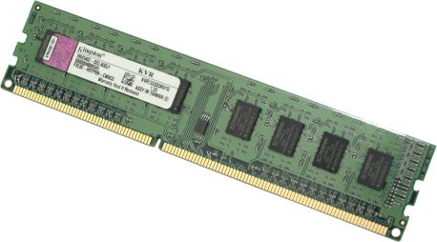
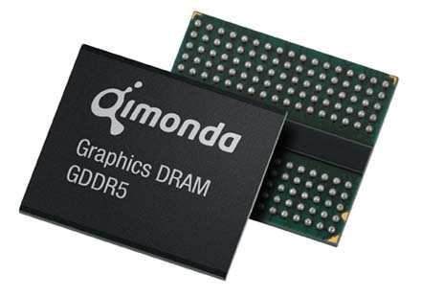
Current Computer Architecture

Slide 7
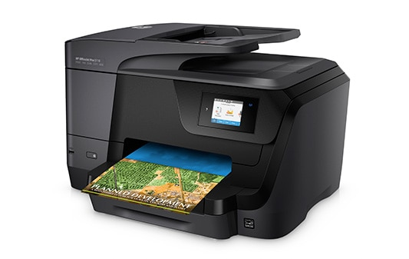


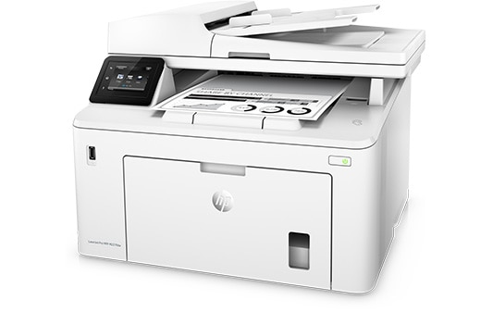
What if printers all had different ink cartridges

Slide 8

Oh wait...

Slide 9





Imagine if GPU were the same

Slide 10



Slide 11


Set of functions to talk to GPU
Almost everything supports now
All C/C++ code
ES stands for “Embedded Systems”
Lighter version, runs on Phones

Slide 12

All browsers agree on a spec
Talks to OpenGL under the hood
Lets browsers use GPU for 3D graphics
Supports around 98% of devices in world

Slide 13

How it all works

Slide 14
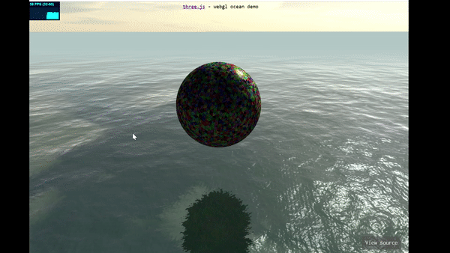
Time for some ThreeJS now!

Slide 15
Level of Abstraction
High Level
Unity or Unreal Engine
Pros: Can make cool things fast
Cons: Performance cost and programmable limits
Lower Level
Raw WebGL/OpenGL
Pros: Limit is your imagination
Cons: Limit is your time and patience
Taught in CS 559 – Will teach you a LOT about graphics

Slide 16
The middle ground
ThreeJS
Framework that wraps WebGL
High level to make developing fast and easy
Low level to still let you do anything
Works basically on every device

Slide 17
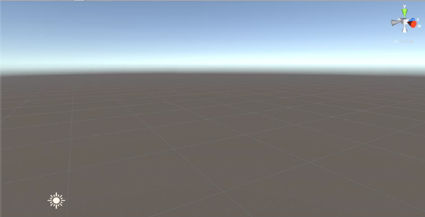

The Scene
The entire 3D realm your graphics live
Everything has a (x,y,z) coordinate

Slide 18
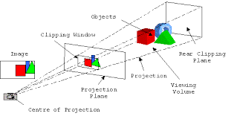
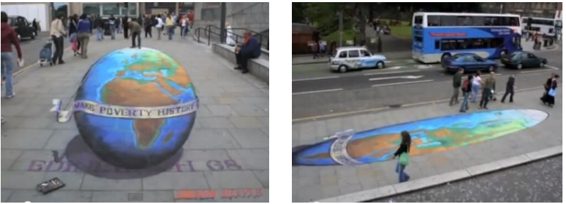
Camera – The View

Slide 19
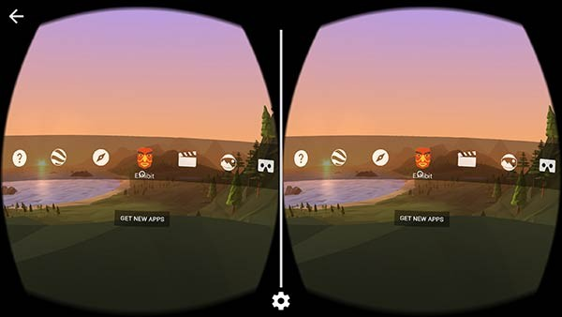
Camera – The View
VR isn’t too much different
Same camera, split into two views for headset

Slide 20
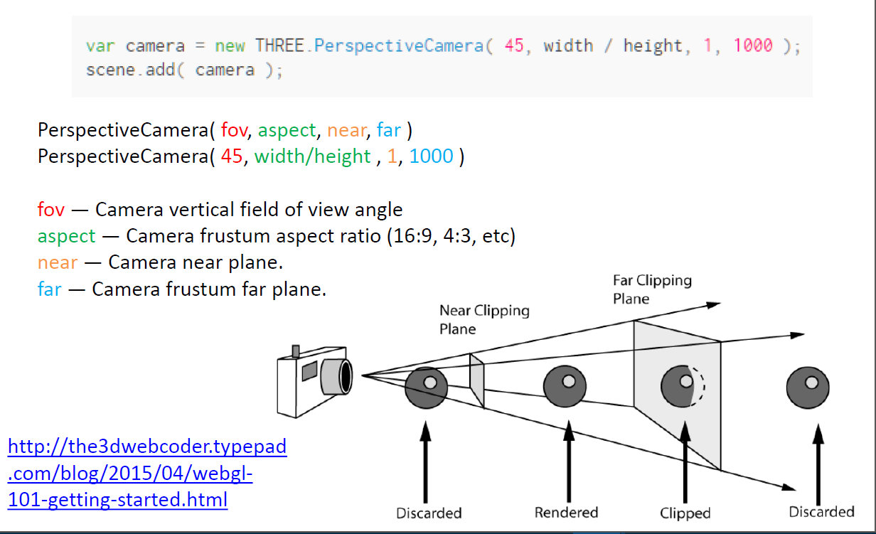
Camera in ThreeJS

Slide 21
3D Models
Nurbs
Mathematically based
SolidWorks, AutoCAD
Used for realistic modeling
Hard to model
Pologonal
Shape made up of individual Vertices
Maya, Blender, 3ds Max
Can look like anything you want
Used for Movies CGI, Games, VR, etc

Slide 22
3D models
Collections of Vertices that each have (x,y,z)
3 or more Vertices make a Face
Ex. Cube
Has 8 Vertices, 12 Edges, 6 Faces

Slide 23
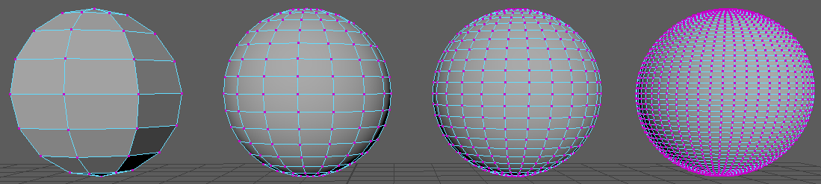
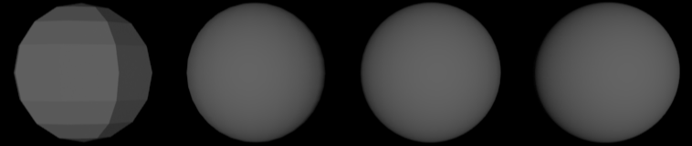
Poly Count
The more vertices, the more realistic/detailed
Also more computer has to computer.
58 Verties
64 Faces
242 Verties
256 Faces
554 Verties
576 Faces
2452 Verties
2500 Faces

Slide 24
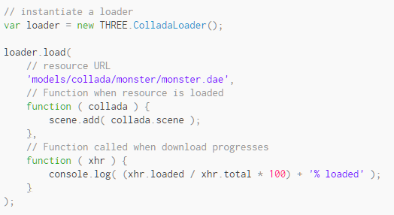
Importing Models – THREE.js
THREE.js has “loaders” for various types

Slide 25
Animation Cycle
Everytime the program computes and displays the image results
Called “Frames”
Note: 1sec / 60 = 16.6 ms
That’s not much time for a computer to compute everything it needs

Slide 26
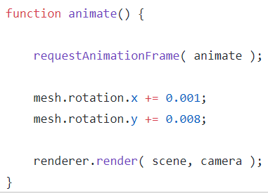
Animation Cycle – THREE.js

Slide 27
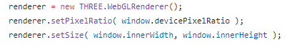
Renderer
The part that makes the WebGL calls
LOTS of “magic” under the hood
Accept it works to start off

Slide 28
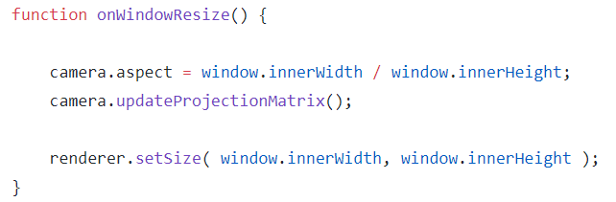
Animation Window Resize

Slide 29
Material and Textures
Material != Textures
Material can have multiple textures on them
Each object has only 1 material on it.
A more complex object can be made of many smaller objects (ex. Car has different materials for tires then doors)
Materials hold info like Color, Transparency, Reflection, etc.
Textures are generally pictures (.jpeg, .png, etc.)

Slide 30
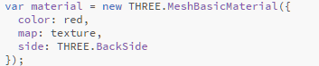

Material – THREE.js
← Many parameters possible to set

Slide 31
Lights
#1 answer to “why is my scene not loading?”
Can have multiple light sources
Different types
Can set light color, intensity, direction, etc
Light controls how materials look like
Ex. Red in bright light looks different then dim light
Could take a whole semester course in lighting both theoretical or practical

Slide 32
Light Types
Ambient
Objects have basic light to them, no direction therefore no shadows
Default in ThreeJS
Direction
Simulates a even light source all aimed in same direction
Most common type for a sun
Point / Spot
Light has a source coordniate and is pointed in a direction
Equivlent of turning a flash light on in a dark room
Area
Light has a source coordniate
Emits lights in all directions around it

Slide 33

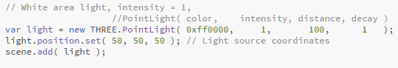
Lights – THREE.js

Slide 34
Time to get some practice!
https://github.com/ uwmadisonieee/Tutorials

